Slide 1

VECTO FF
05/2020
Release Notes

Slide 2
New VECTO Graphical User Interface May 2020
Remarks
This is a first version to evaluate a new, more flexible and better structured graphical user interface.
The new graphical user interface “VECTO 3” currently allows only creating and editing bus-related job files and component data. This is: completed bus XML, completed bus job file, single bus job file. Support for further VECTO Job data and component data is planned for the future.
This GUI allows to simulate existing VECTO jobs (heavy lorries, medium lorries, engine only, …)
The functionality of the new graphical user interface is similar to the currently official VECTO version
This draft version is intended to be used in the 2020 pilot phases. Features of final / long-term version to be discussed with Commission and stakeholders after feedback.

Slide 3
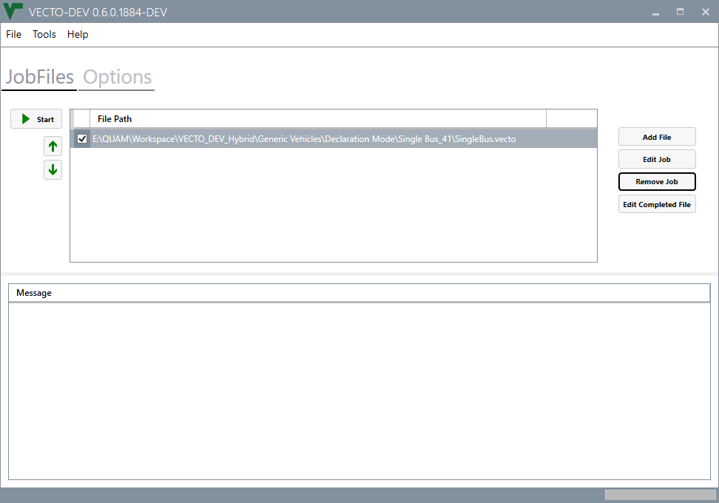
Main Window – Jobs View
Buttons to start/stop the VECTO simulation and re-order jobs
List of VECTO Jobs. Selected jobs are simulated when clicking the “Start” button. Adding jobs can be done either via the “Add File” button to the right of via drag&drop from the file explorer
Buttons to add job files, edit job files from the job list, remove the selected job from the job list.
Message List. The output during the simulation is shown in the message this. This includes the simulated jobs, detected cycle types, Errors occurring during simulation and the generated results of the simulation
Progress Bar. Shows the progress of every single simulation run as well as the overall progress during the simulation

Slide 4
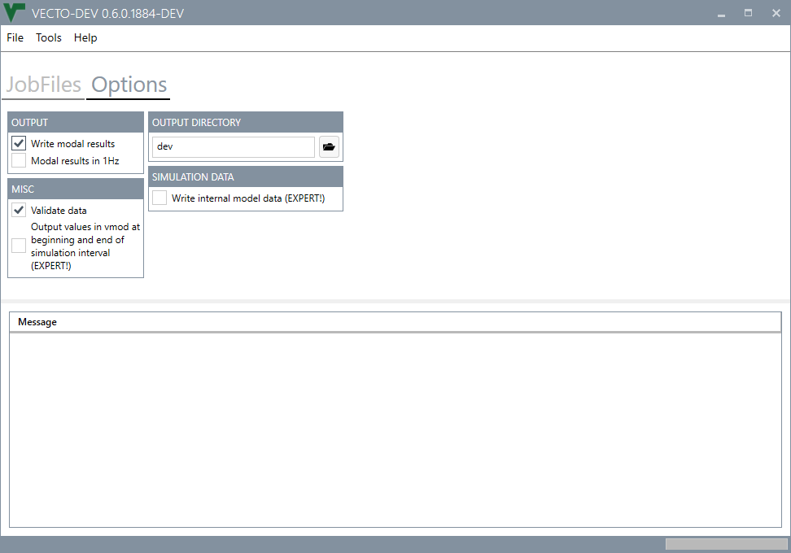
Main Window – Options
Options for VECTO Simulations related to generation of result files, validation options, etc. These options are the same as in the current VECTO version.

Slide 5
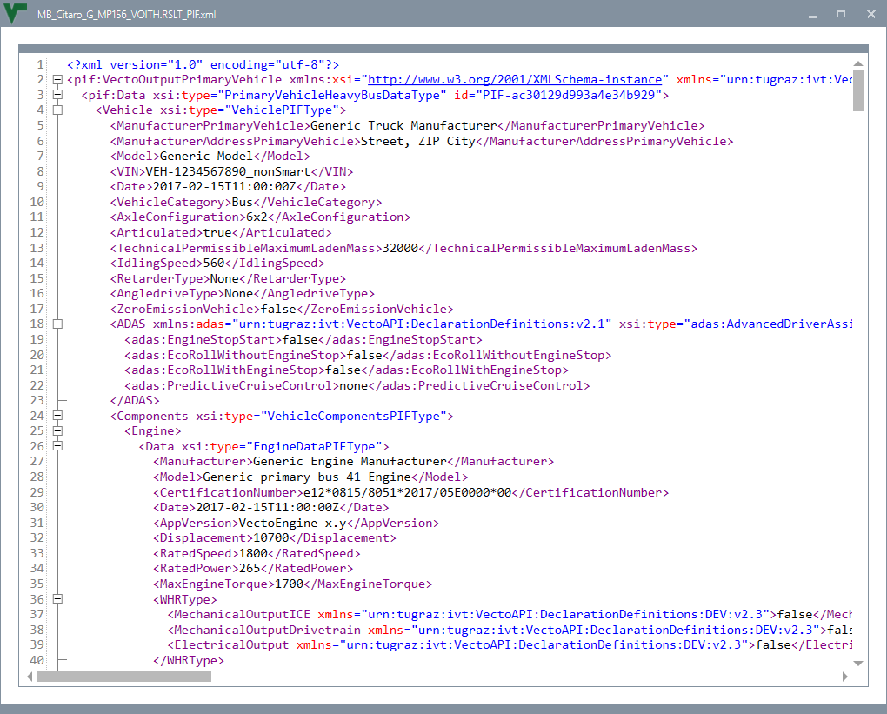
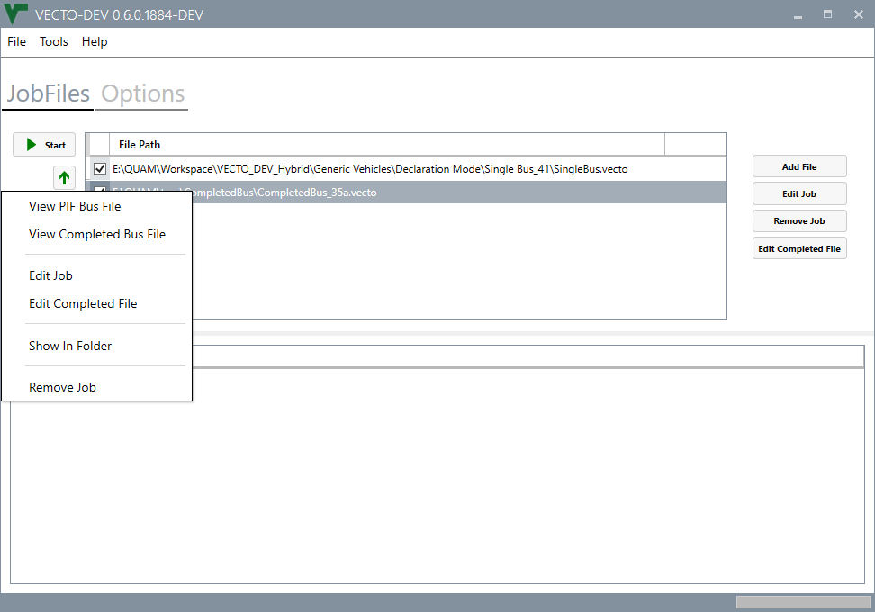
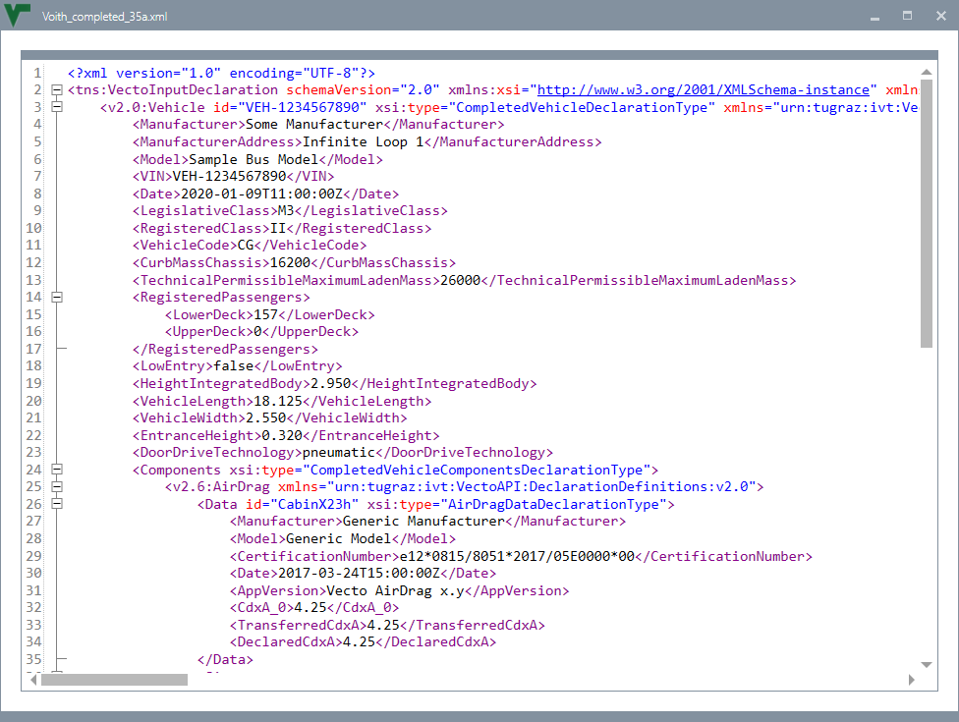
Main Window – Job List Context Menu
The context menu of a job entry allows to view the XML files of the primary vehicle XML, primary vehicle information file, completed bus XML.
It is also possible to edit known VECTO job files and known vehicle files (completed bus)

Slide 6
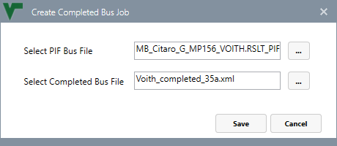
Creating / Editing Completed Bus Job
For a completed bus job the PIF file and the completed bus XML file need to be provided.
The dialog for a single bus job is similar. A single bus job requires the primary bus XML file and the completed bus XML file.

Slide 7
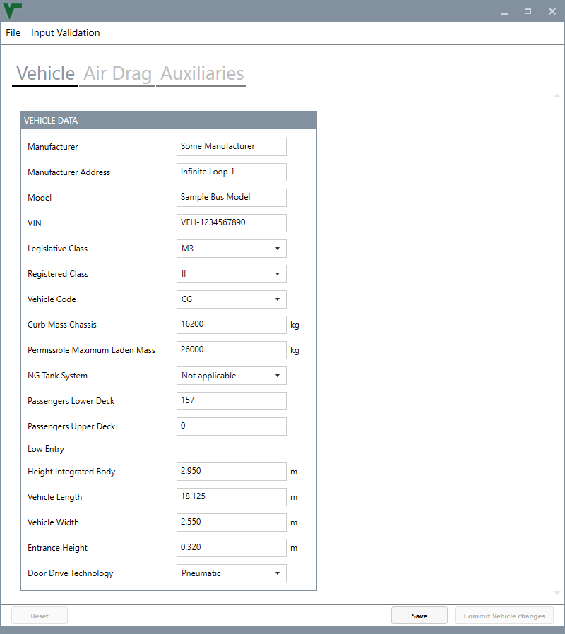
Completed Bus Input Data – Vehicle
Dialog for editing the input parameters of a completed bus XML.
A separate tab is provided for every component (see screenshots on the following slides)
Save changes to the file
Store changes to the current component VECTO internally (changes are NOT saved to the file). Future changes can be undone with the ‘Reset’ button

Slide 8
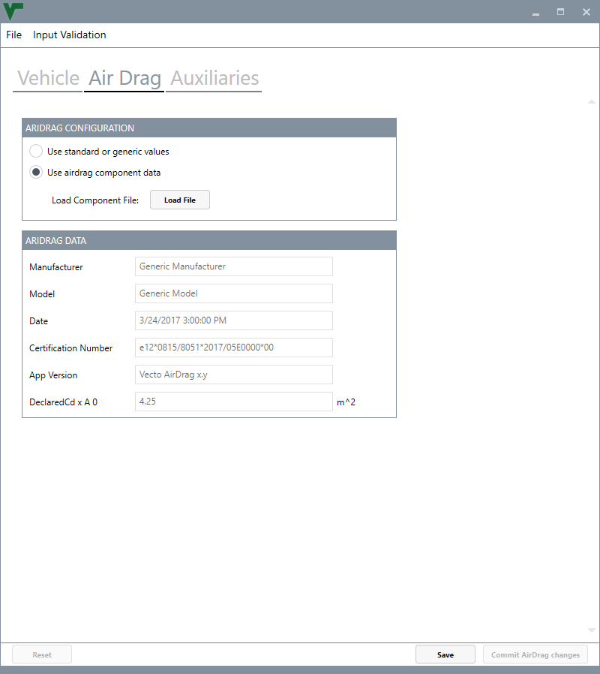
Completed Bus Input Data – Air Drag

Slide 9
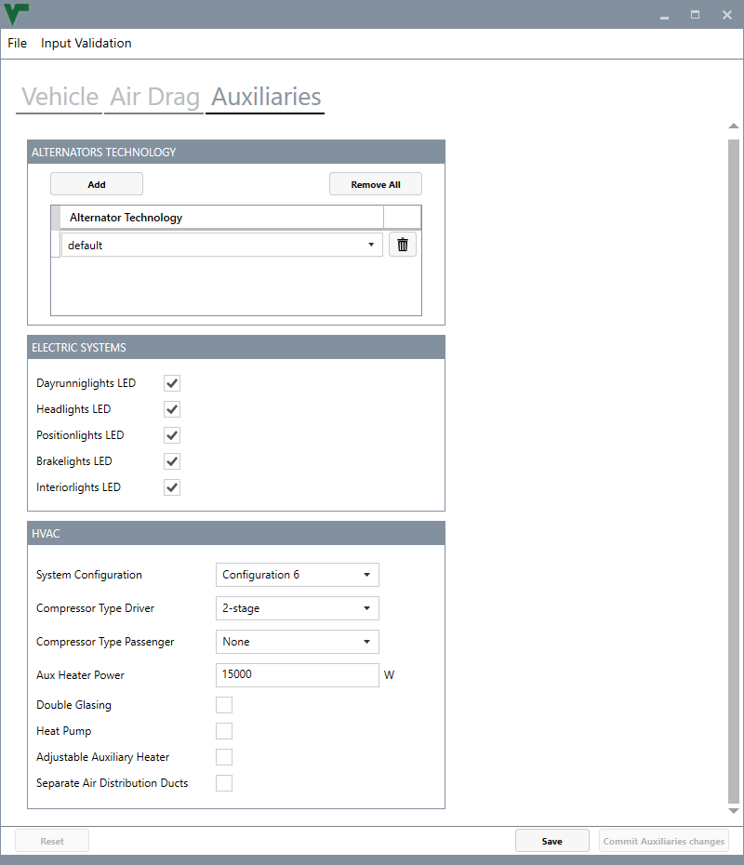
Completed Bus Input Data – Auxiliaries

